Slide 1
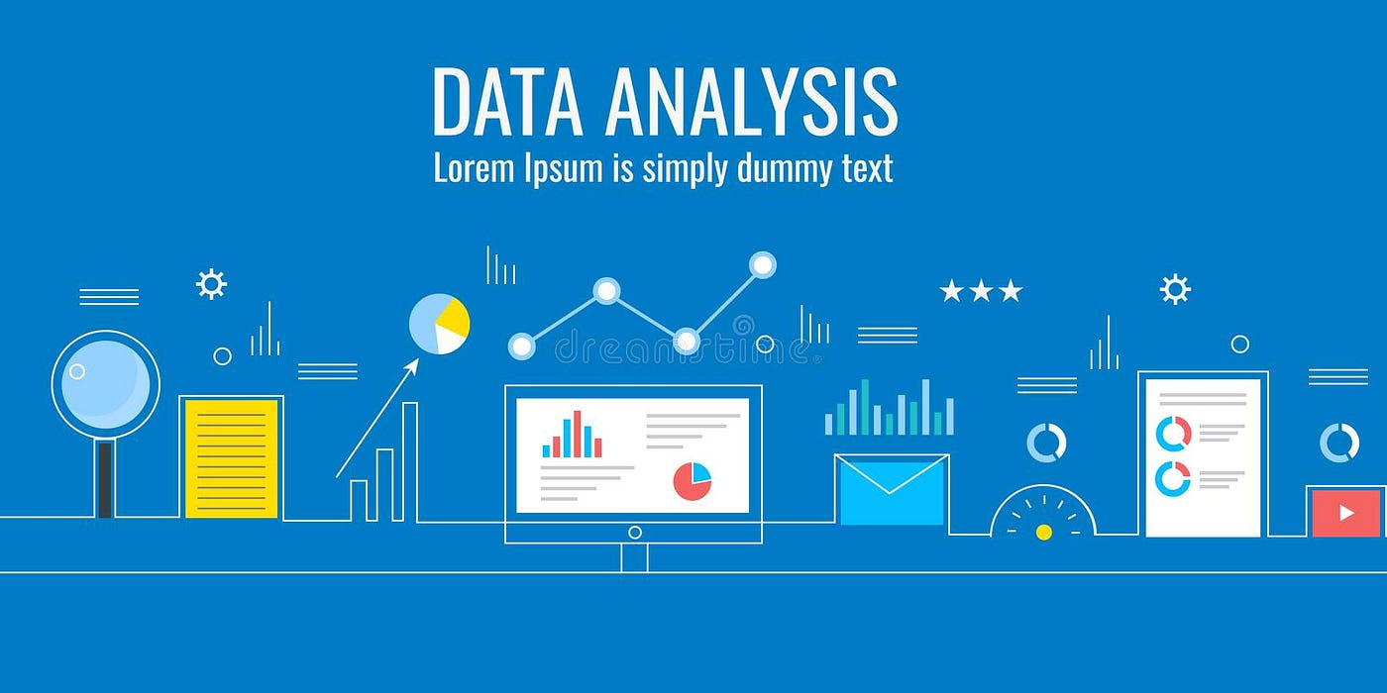
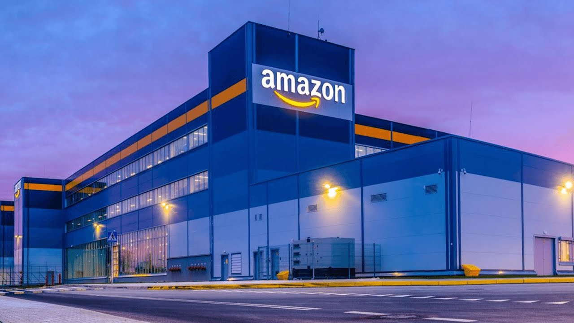
Amazon Sales Trend Analysis and Insights
CHELLAPANDI M

Slide 2

Title : Amazon Sales Trend Analysis and Insights
Domain : Data Analyst Intern
Company :
Duration : Nov 2024 – Dec 2024
Problem Description:
The provided dataset contains information about sales transactions on Amazon, including details such as order ID, date, status, fulfilment method, sales channel, product category, size, quantity, amount, shipping details , and more. The objective is to conduct a comprehensive analysis of the data and extract actionable insights to
support business decision-making.
Datasets:
https://drive.google.com/file/d/1YrjYKtS1WHmINL6eafRsrDzrZaw2_WvX/view?usp=sharingview?usp=sharing
Tools:
Google colob

Slide 3
Key Objectives:
Sales Overview: Understand the overall sales performance, trends, and patterns over time.
Product Analysis: Analyze the distribution of product categories, sizes, and quantities sold to identify popular products.
Fulfillment Analysis: Investigate the fulfillment methods used and their effectiveness in delivering orders.
Customer Segmentation: Segment customers based on their buying behaviour, location, and other relevant factors.
Geographical Analysis: Explore the geographical distribution of sales, focusing on states and cities.
Business Insights: Provide actionable insights and recommendations based on the analysis to optimize sales strategies, improve customer satisfaction, and enhance overall business performance.

Slide 4
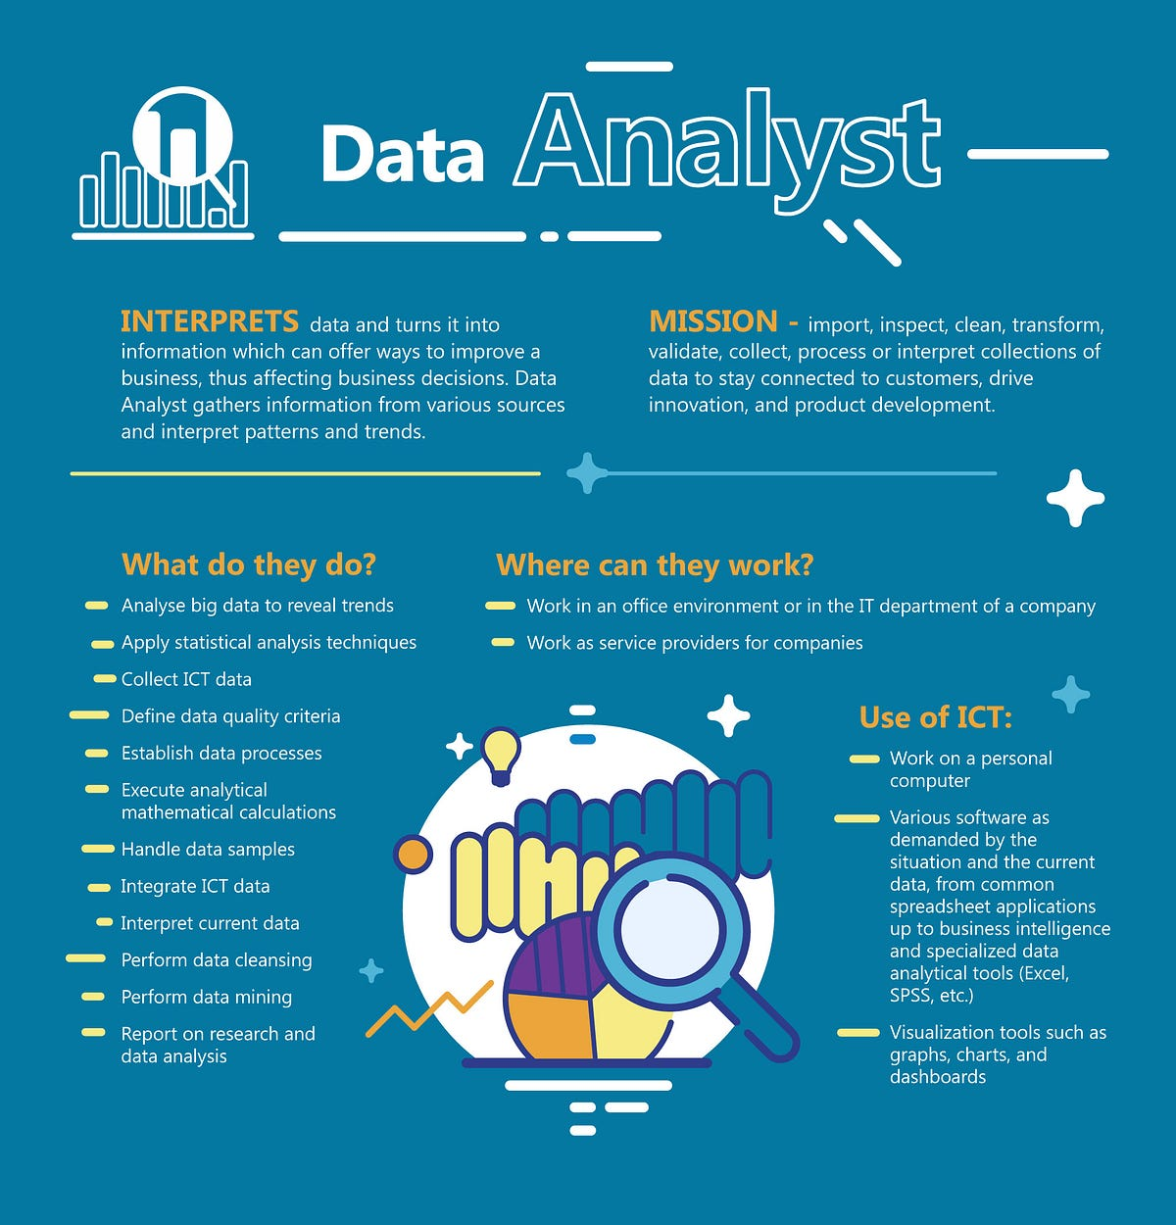
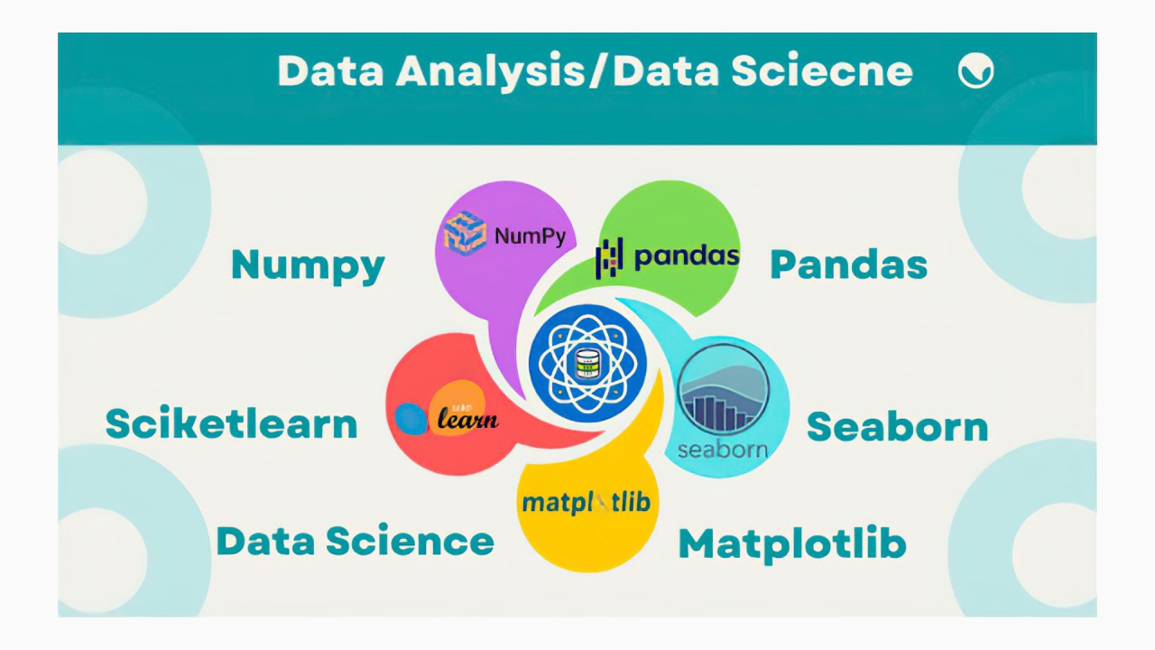
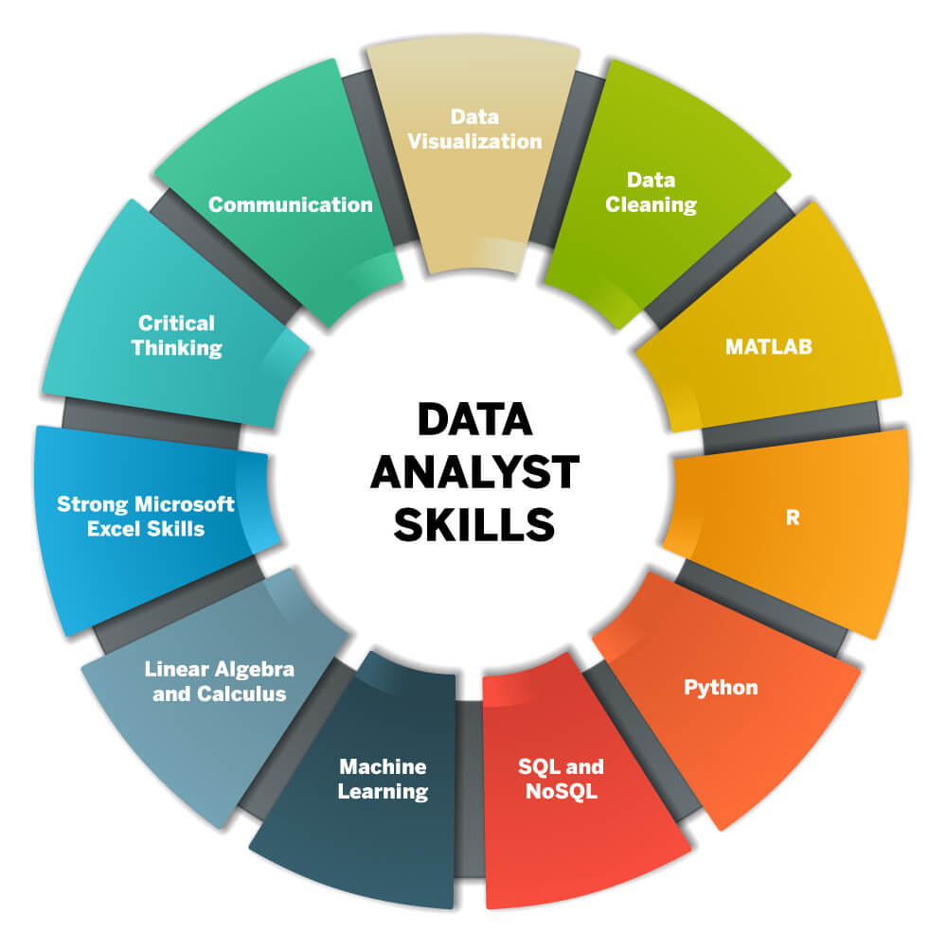

Slide 5
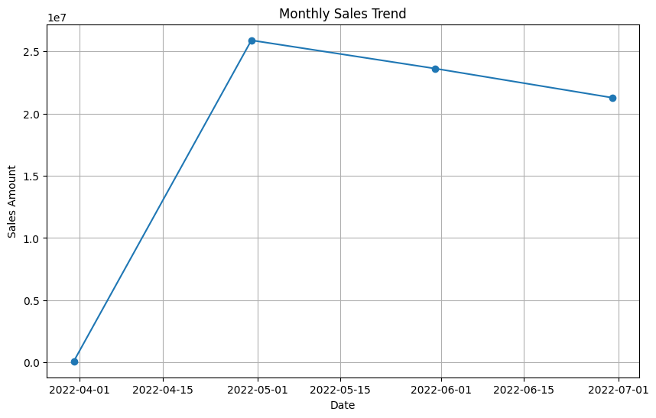
Monthly Sales Trend
Sales Peaked In April And Then Gradually Declined Over The Following Months

Slide 6
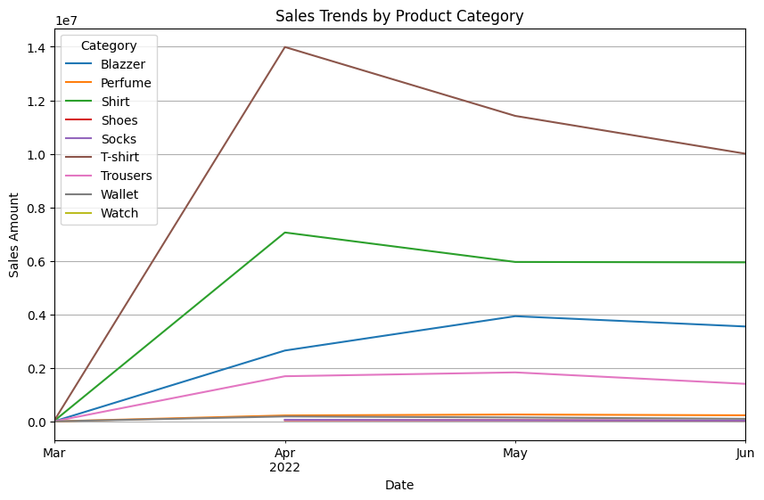
Sales Trends by Product Category
T-shirts and Shirts consistently generated the highest sales, with T-shirts peaking in April.
Blazzer and Trousers also saw significant sales but with more fluctuation.
Perfume, Shoes, Socks, Wallet, and Watch had lower sales overall, with some categories like Shoes and Socks having no sales in March.

Slide 7
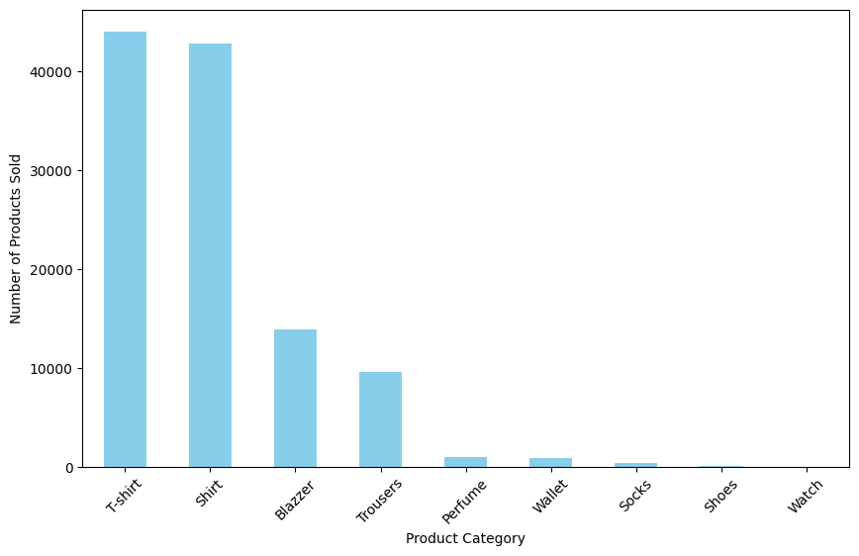
Product Analysis
Distribution of product categories
T-shirts and Shirts are the top-selling categories, with T-shirts leading in quantity sold.
Blazzer and Trousers follow, with significantly lower quantities compared to T-shirts and Shirts.
Perfume and Wallet have modest sales, while Socks, Shoes, and Watch have very low quantities sold.

Slide 8
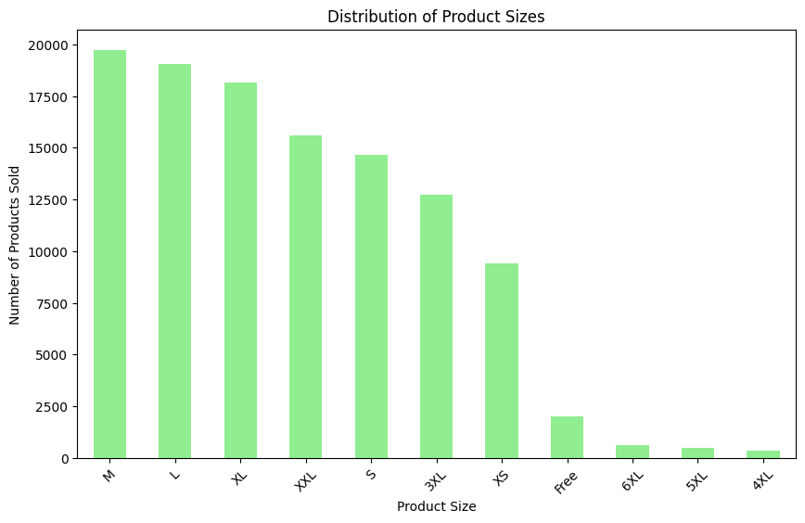
Product Analysis
Distribution of Product Sizes
Medium (M) and Large (L) are the most popular sizes, with nearly equal high quantities sold.
Extra Large (XL) and Double Extra Large (XXL) follow, showing strong sales.
Small (S) and Triple Extra Large (3XL) also have substantial quantities sold.
Extra Small (XS) and Free Size have lower sales compared to the other sizes.
6XL, 5XL, and 4XL are the least sold sizes, with significantly lower quantities.

Slide 9
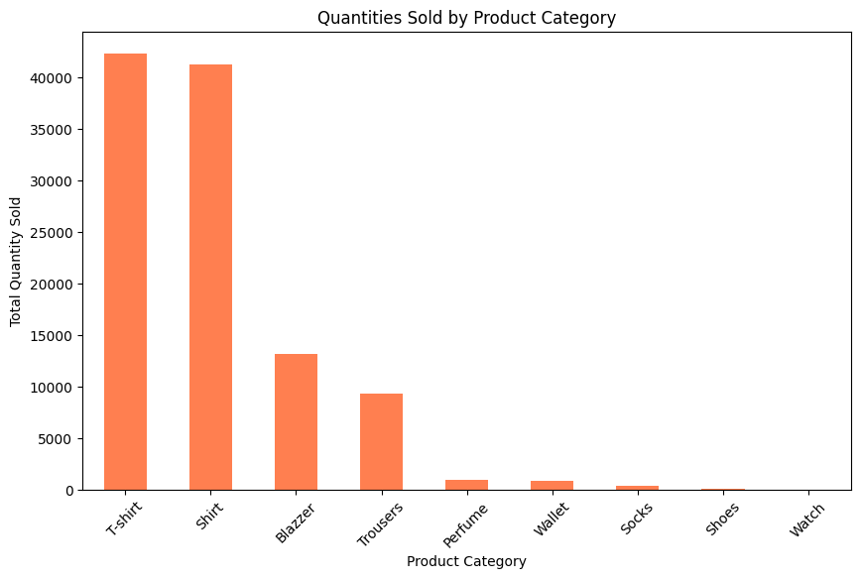
Product Analysis
Quantities Sold by Product Category
T-shirts and Shirts are the top-selling categories, with T-shirts leading in quantity sold.
Blazzer follows, with a significantly lower quantity compared to T-shirts and Shirts.
Trousers also show a notable amount of sales.
Perfume and Wallet have moderate quantities sold.
Socks and Shoes have low sales, with Shoes having the least quantity sold.
Watch has minimal sales with only 1 unit sold.

Slide 10
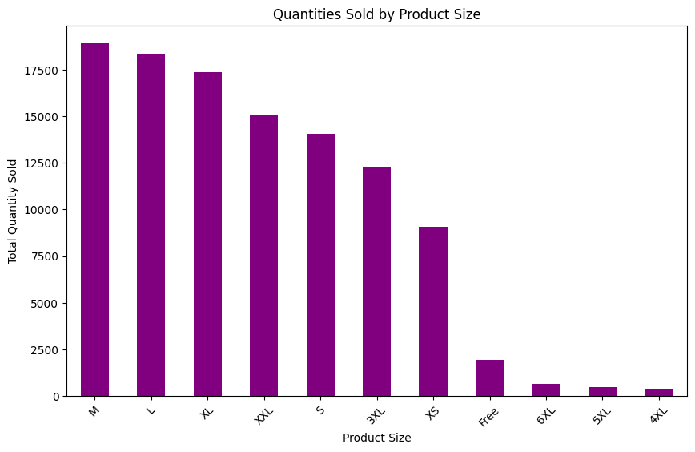
Product Analysis
Quantities Sold by Product Size
Medium (M) and Large (L) sizes are the most popular, with Medium slightly ahead in quantity sold.
Extra Large (XL) and Double Extra Large (XXL) follow, with substantial sales.
Small (S) and Triple Extra Large (3XL) have strong sales, though less than the larger sizes.
Extra Small (XS) and Free Size have lower sales volumes.
6XL, 5XL, and 4XL are the least sold sizes, with significantly fewer units sold.

Slide 11
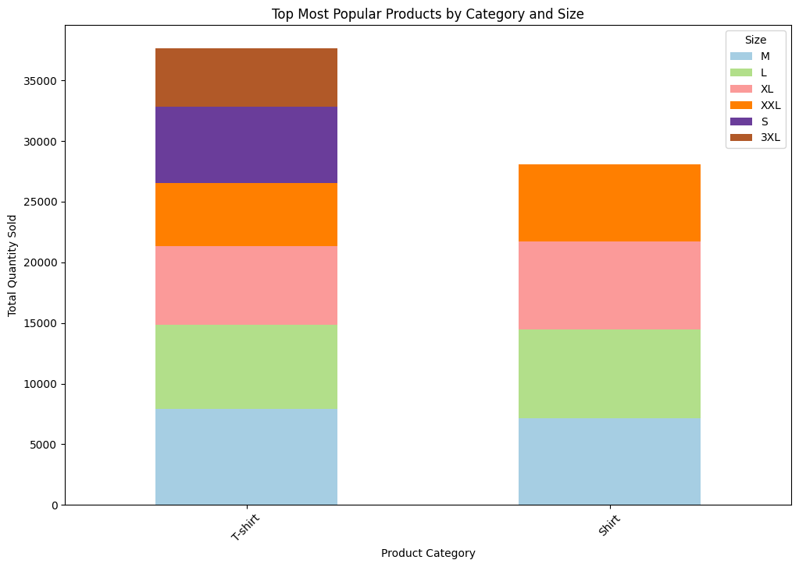
Product Analysis
Top Most Popular Products by Category and Size
T-shirts are sold in all sizes, with Medium and Large being the top-selling sizes.
Shirts also have substantial sales across multiple sizes, with Large and Extra Large leading in quantity sold.
Both T-shirts and Shirts show strong performance in sizes M and L, while T-shirts have notable sales in Small and XXL as well.

Slide 12
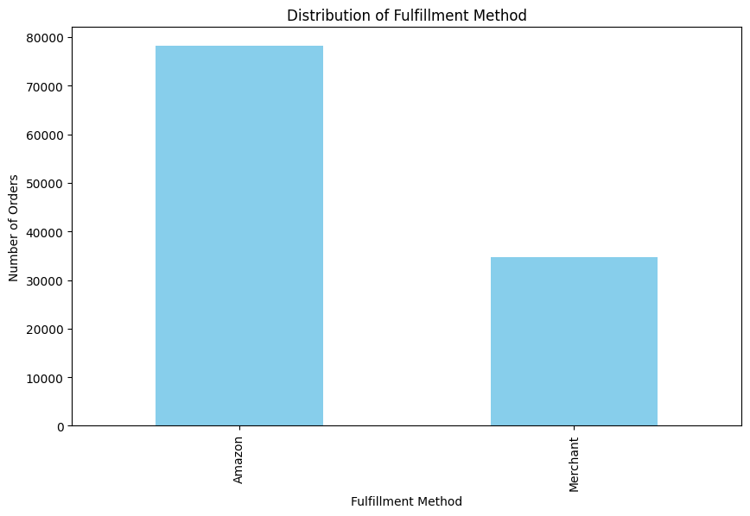
Fulﬁllment Analysis
Distribution of Fulfillment Method
Amazon is the dominant fulfillment channel, with significantly higher sales compared to Merchant.
Merchant fulfillment accounts for a smaller portion of the total sales, indicating that Amazon is the primary channel for these sales.

Slide 13
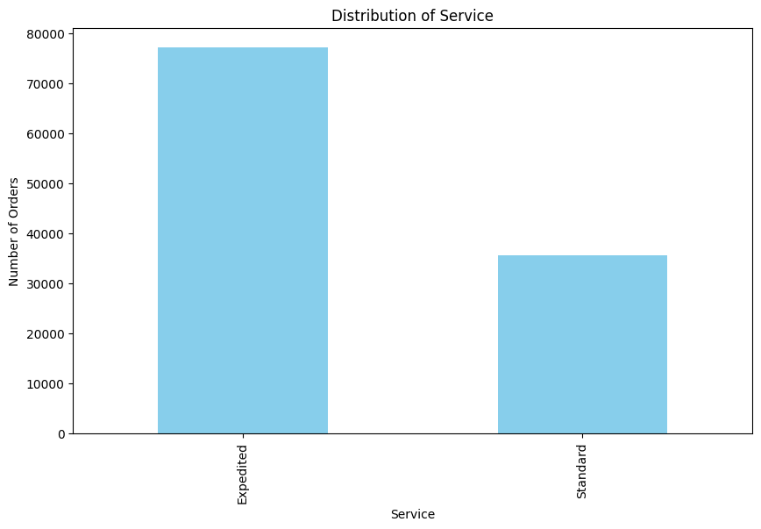
Fulﬁllment Analysis
Distribution of Service
Expedited service is the preferred choice, with a significantly higher number of units fulfilled compared to Standard service.
Standard service accounts for a smaller portion of the total sales, indicating that expedited delivery is more commonly used or preferred.

Slide 14
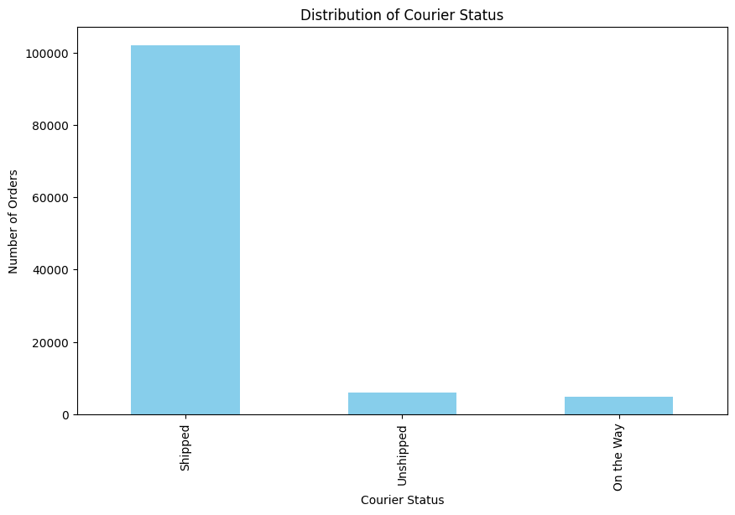
Fulﬁllment Analysis
Distribution of Courier Status
Shipped is the predominant status, with a significantly higher number of units compared to Unshipped and On the Way.
Unshipped and On the Way have much lower quantities, indicating that most of the orders have already been shipped.

Slide 15
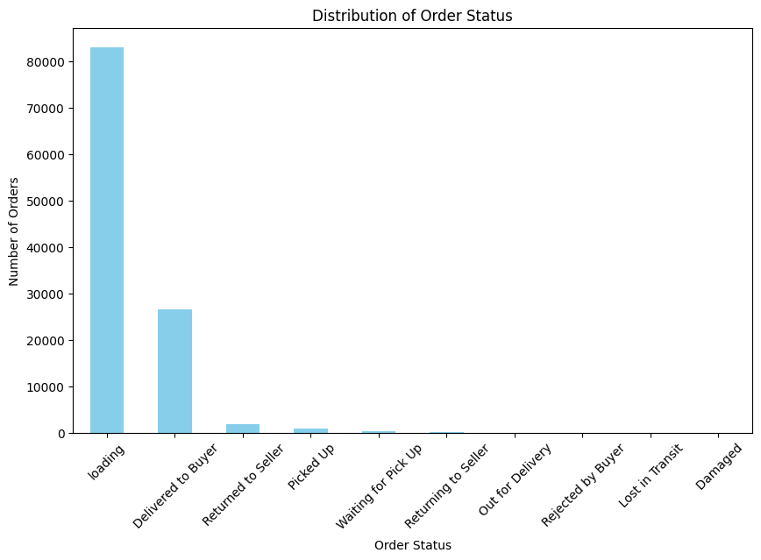
Fulﬁllment Analysis
Distribution of Order Status
Loading has the highest quantity, indicating that a large number of orders are still in the process of being prepared or shipped.
Delivered to Buyer shows a significant number of completed transactions.
Returned to Seller and Picked Up have relatively small quantities compared to the other statuses.
Waiting for Pick Up, Returning to Seller, and other statuses such as Out for Delivery, Rejected by Buyer, Lost in Transit, and Damaged have minimal quantities, indicating less frequent occurrences.

Slide 16
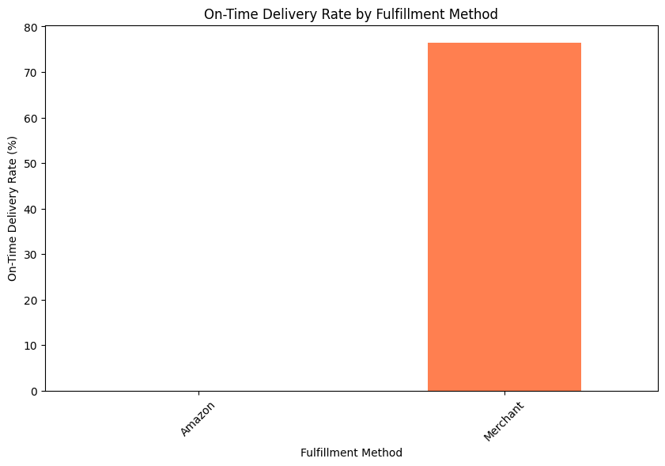
Fulﬁllment Analysis
On-Time Delivery Rate by Fulfillment Method
Amazon has an on-time delivery rate of 0%, which might indicate no data available or a reporting issue for this channel.
Merchant has a substantial on-time delivery rate of 76.48%, suggesting that this channel performs well in terms of timely deliveries.

Slide 17
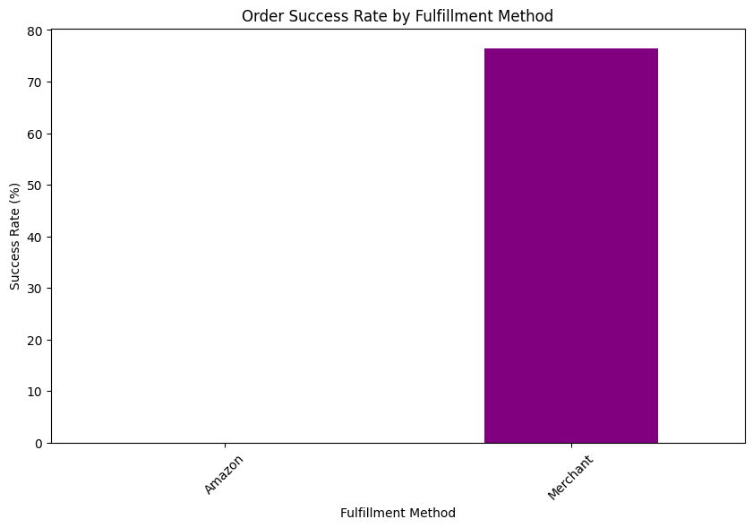
Fulﬁllment Analysis
Order Success Rate by Fulfillment Method
Amazon: No data available for the number of orders fulfilled through Amazon, indicating either missing data or no orders recorded for this channel.
Merchant: A total of 76.48 orders were fulfilled, though the fractional value suggests it might be an average or aggregate figure.

Slide 18
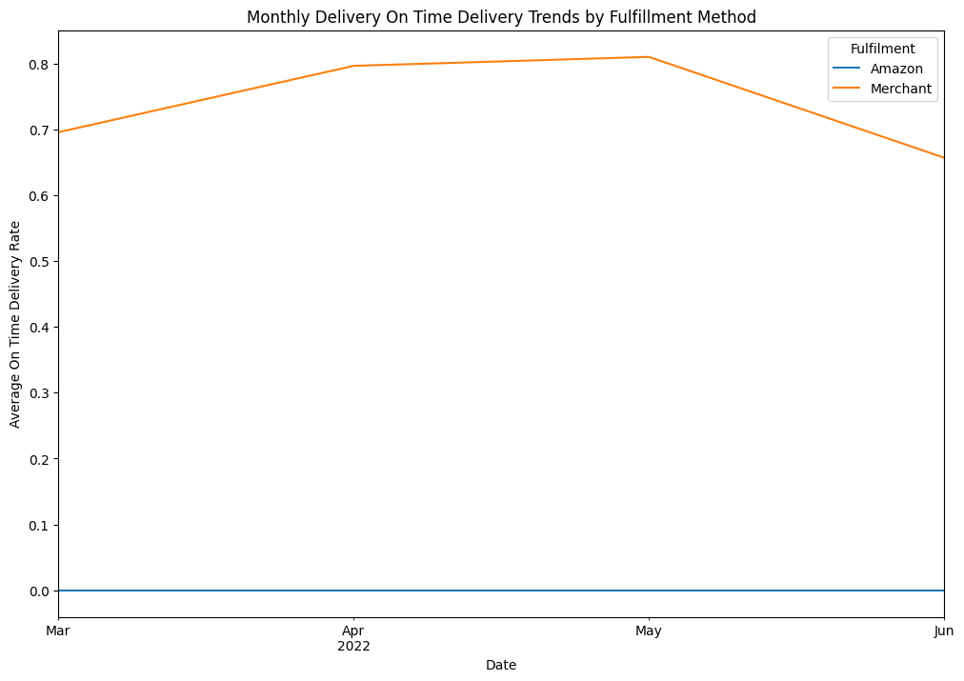
Fulﬁllment Analysis
Monthly Delivery On Time Delivery Trends by Fulfillment Method
Amazon shows a fulfillment rate of 0.0 across all dates, indicating either no data available, no orders fulfilled, or an issue with reporting for Amazon.
Merchant shows varying fulfillment rates across the dates: March 2022: 69.6% April 2022: 79.6% May 2022: 81.0% June 2022: 65.7%
Merchant’s fulfillment rates are relatively high, with a peak in May and a decrease in June.

Slide 19
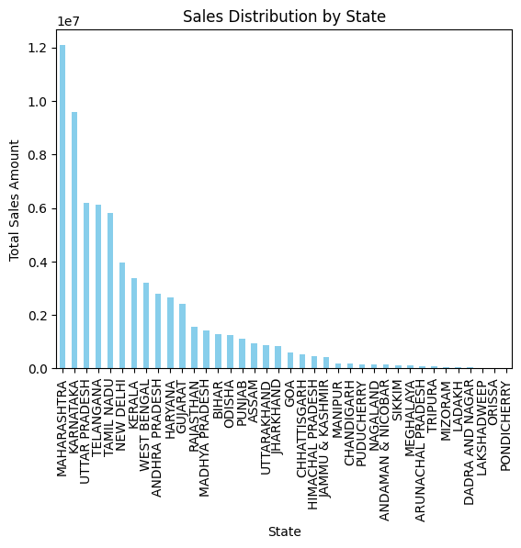
Geographical Analysis
Sales Distribution by State
Maharashtra has the highest total sales with over 12 million.
Karnataka, Telangana, Uttar Pradesh, and Tamil Nadu also have high sales figures, all above 5 million.
Lakshadweep, Pondicherry, and Orissa have the lowest sales, with figures under 3,000.
The Northern and Southern regions, particularly Maharashtra, Karnataka, and Tamil Nadu, dominate the sales distribution.

Slide 20
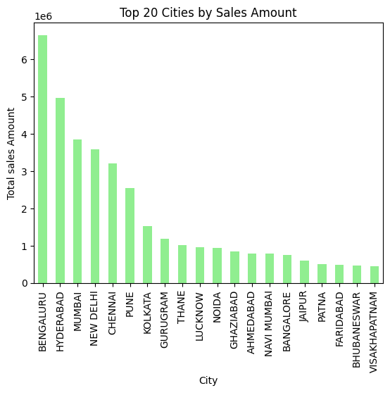
Geographical Analysis
Top 20 Cities by Sales Amount
Visualize Sales Distribution by City in Indian

Slide 21
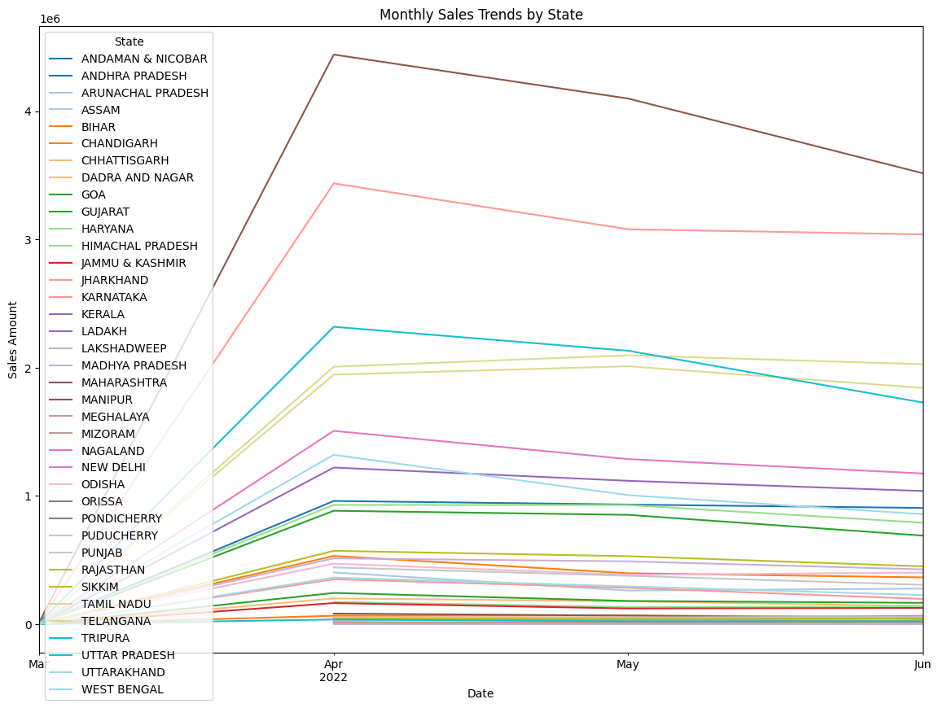
Geographical Analysis
Monthly Sales Trends by State
April month is the highest sales growth

Slide 22
Business Insights
Focus marketing on T-shirts and Shirts as top-selling categories.
Maintain high stock for Medium (M) and Large (L) sizes; reduce overstock of niche sizes.
Strengthen expedited delivery to meet customer preferences.
Target high-performing regions like Maharashtra and Karnataka with campaigns.
Launch promotions for low-performing products like Shoes and Watches.
Implement loyalty programs to retain frequent buyers.
Optimize logistics to reduce unshipped orders and improve customer satisfaction.
Conclusion:
The analysis of the Amazon sales transactions dataset provided valuable insights that can be used to support strategic decision-making, enhance operational efficiency, and drive business growth. Through data cleaning, exploratory data analysis, and data visualization, the report offers a comprehensive understanding of the sales performance and identifies key opportunities for improvement

Slide 23



